Slide 1

AI-Based Customer Support Chatbot
(A Smart Healthcare Solution)
AI-Based Customer Support Chatbot is the idea that aims at solving Healthcare collaboration problems.
by
Dharmendra Kumar Nayak
(UNIVERSITY ID O24MSD250100)
Master of Science (Hons.) in Data Science Chandigarh University

Slide 2

AI Chat has revolutionized every industry, including healthcare.
Healthcare is vast and complex — made up of multiple independent entities.
Lack of integration causes delays, and inefficiency.
INTRODUCTION

Slide 3
What is AI-Based Customer Support Chatbot
A smart AI web-based chat platform connecting all healthcare stakeholders: 🏥 doctors | 👩‍⚕️ patients | 🔬 researchers | 💊 pharmacists | 🏛 government
Enables sharing, collaboration, and data-driven decision-making.
Bridges the communication gap and improves healthcare outcomes

Slide 4
Purpose of the System
To integrate SMART CHAT healthcare components: doctors, patients, researchers, insurers, pharma.
Build a collaborative cloud platform for data sharing & analytics.
Solve key issues:
Improve customer satisfaction through instant response times.
Enable real-time collaboration for evidence-based healthcare.

Slide 5
Target Audience
Patients: Share medical history, access care anytime.
Doctors & Clinicians: Access records instantly; collaborate globally.
Researchers: Use real-world anonymized data for studies.
Pharmaceuticals: Analyze disease trends for R&D.
Healthcare & Insurance Organizations: Use analytics for better policies & planning.

Slide 6
Functionality
Core functions:
Patient registration & health record entry.
Controlled record sharing (with authorization).
Doctor–researcher collaboration.
Access control & expertise sharing. Enhanced features:

Slide 7
Technical Architecture (react python)
REACT
Client Tier:
User interface (REACT web apps).
Middle Tier:
Business logic layer (Enterprise Beans, Web Services, PYTHON).
Data Tier:
Database for secure, persistent storage. Technology Stack:

Slide 8
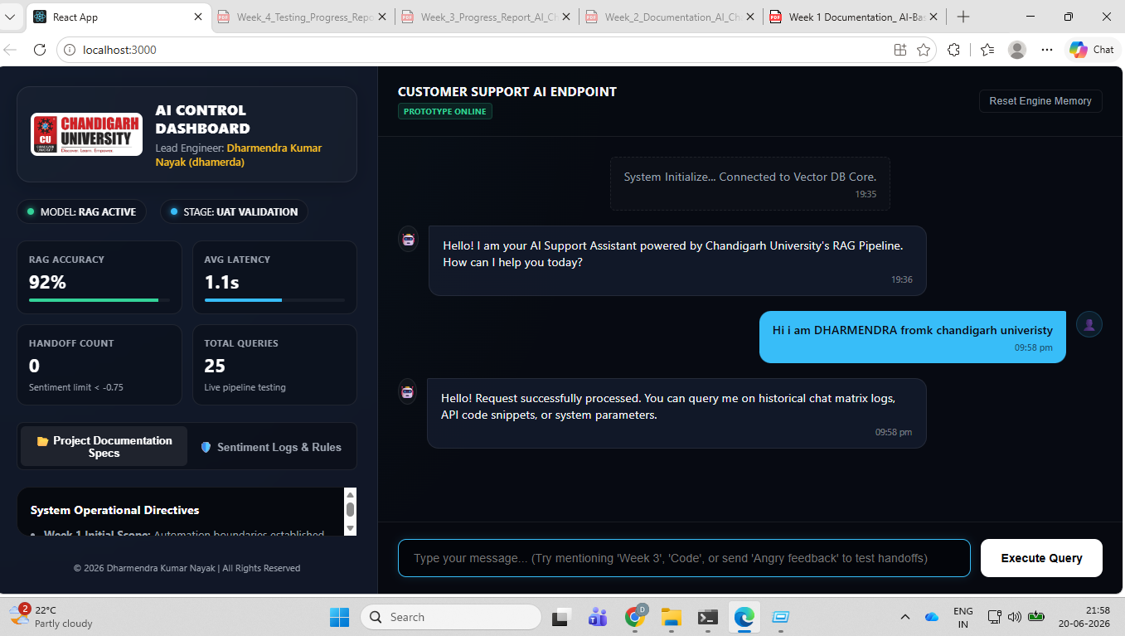
Application Screen

Slide 9
Research Methods
Primary Research:
Interviews & Questionnaires
Subjects: Healthcare professionals, researchers
Objectives: Understand daily issues, record usage, collaboration needs
Secondary Research:
Academic journals, whitepapers, IBM & PwC healthcare reports
Technical references: Oracle, rEACT frameworks

Slide 10
Conclusion
Existing healthcare systems lack integration & collaboration.
The AI-Based Customer Support Chatbot connects all healthcare stakeholders.
Benefits:
24×7 record access
Evidence-based decisions
Reduced costs & improved outcomes
Future Scope: AI analytics, remote diagnosis, global data interoperability.

Slide 11

THANK YOU
by
Dharmendra Kumar Nayak
(UNIVERSITY ID O24MSD250100)
Master of Science (Hons.) in Data Science Chandigarh University

